Slide 1


Social Buzz
Category Data Analysis

Slide 2


Today's agenda
Project recap
Problem
The Analytics team
Process
Insights
Summary

Slide 3

Project Recap
3 months Initial project
An audit of their big data practice
Recommendations for a successful IPO

Slide 4


Problem
An analysis of their content categories that highlights the top 5 categories with the largest aggregate popularity

Slide 5


Andrew Fleming
The Analytics team
Marcus Rompton
Sreekanth V

Slide 6
Data Gathering
Process
1
2
Data Cleaning
3
Data Modeling
4
Data Processing & Insights
5
Knowledge

Slide 7
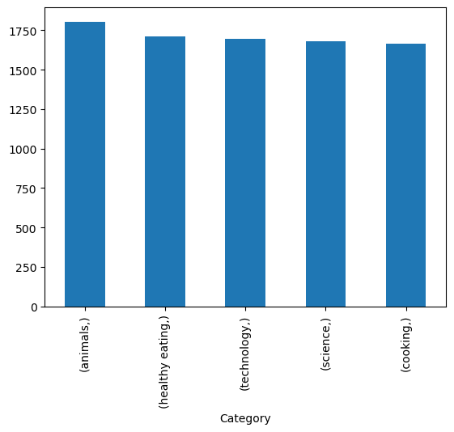

Insights
Top 5 Content Producing category's

Slide 8
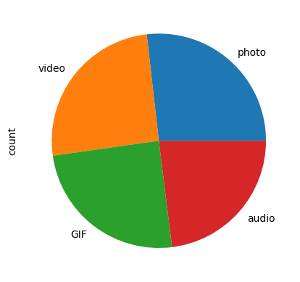
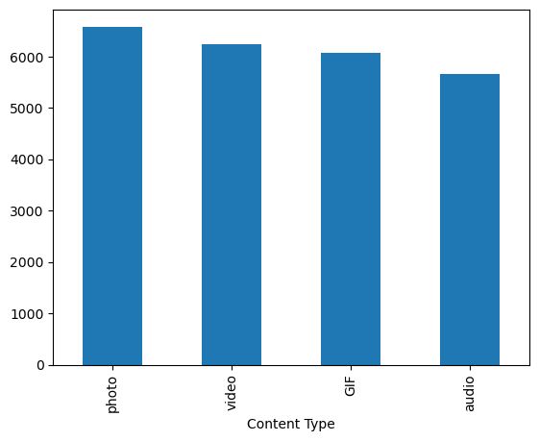
Content Types and metrics

Slide 9
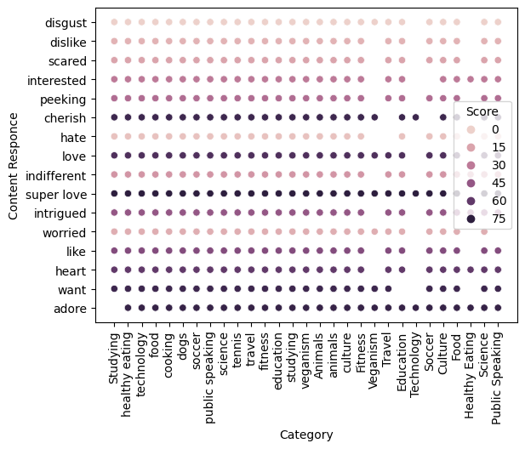
Scores for content type and category

Slide 10

Highlighting of Key Metrics
Summary

Slide 11

Thank you!
ANY QUESTIONS?

